Slide 1
Procurement Services
Works Training for the Approver
Step-by-Step instructions for the Approvers
(Budget Authority/Supervisor or Proxy)

Slide 2
Outline
Role and Responsibility
Introduction to Works
Login and Profile
Approving Transactions (e-Signature)
Other Useful Features and Reporting

Slide 3
Approver Role and Responsibility
Approver role is completed by budget authority or supervisor, or a proxy appointed by the person.
Cannot approve own card. Cannot approve transactions also reconcile/backup reconcile. Must maintain separation of duty.
Approver reviews PCard transactions, fund/account allocation information and documentation before signing off.
Signature is electronic in Works.
Transactions are not encumbered in Banner until the approver signs off and the PCard Administrator batches to Banner.
Monthly deadline to sign off on transactions falls on the 5th of the month. Holidays and Weekends will affect the date.
Sign off frequently.

Slide 4
Introduction to Works
Works is a web-based application offered by Bank of America.
Accessible from anywhere you have internet.
You do not need to be on campus network or VPN
Can access on computer, laptop, smartphone or tablet
Works is a Bookmarkable link: payment2.works.com/works
Make sure to use /works. This portion of the address directs you to the current interface.
Funds in Banner will continue to be encumbered throughout the month, depending on frequency of batches processed by PCard Administrator.
Your Works username may differ from your UNC Greensboro username and is case sensitive. You will receive a Welcome Email with your Works username. It is recommended to change your Works password when you are prompted to change your UNC Greensboro password.

Slide 5
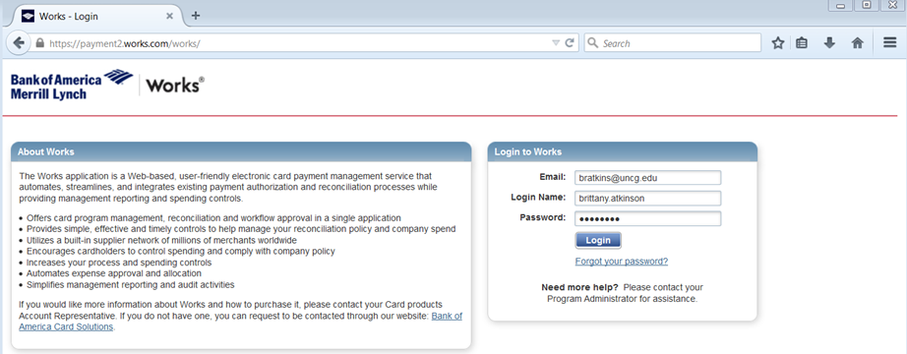
Login
Web address: https://payment2.works.com/works
Your username and password differ from your Banner username and password
Recommend changing your password in Works when UNC Greensboro prompts you to change campus passwords
UNC Greensboro email
Login Name-Username
may differ from Banner username
Password

Slide 6
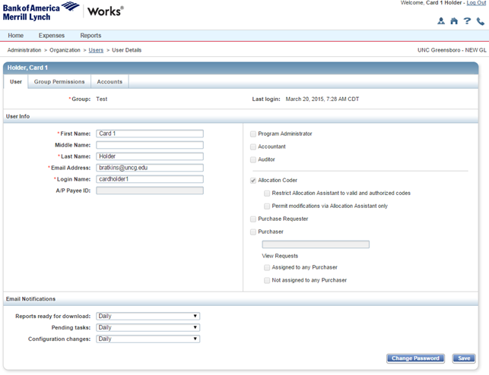
Notification and Profile
Automated emails sent when there are transactions requiring signature
You may set how often to receive emails. The default is “Daily”.
Select the person symbol to modify your settings.
Select from Immediately, Daily or Weekly. Make sure to “Save”. Pending Tasks refers to the transactions signed off by your Reconcilers and awaiting your signature.

Slide 7
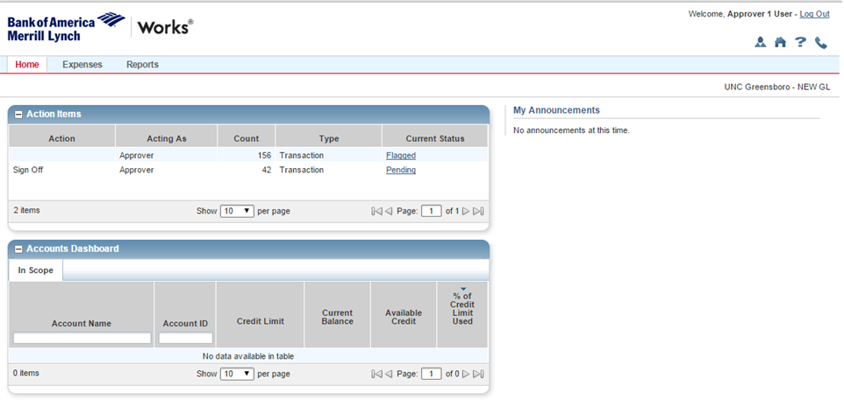
Review and Sign Off
Works will send an automatic email when you have a transaction requiring your sign off.
Log into Works-Your home page will show how many transactions that need to be signed off.
Your home page displays a list of your “Action Items” these are transactions requiring your review and sign off.

Slide 8
To view the transactions and sign off, click on the blue hyperlinked status, “Pending” or “Flagged”.
Pending-new transactions to sign off.
Flagged-transactions that were flagged for correction, now corrected.

Slide 9
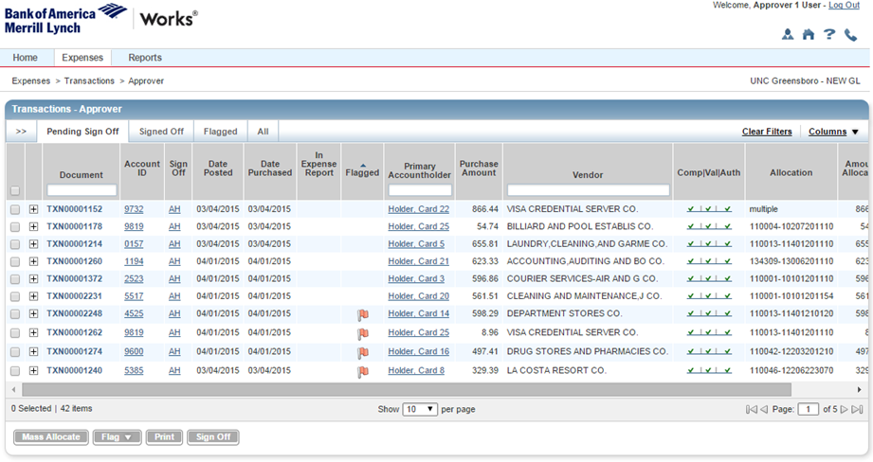
After you click on the blue hyperlink, the transactions requiring your sign off will be listed.
Review fund/account allocation, comments, receipts for accuracy, etc.

Slide 10
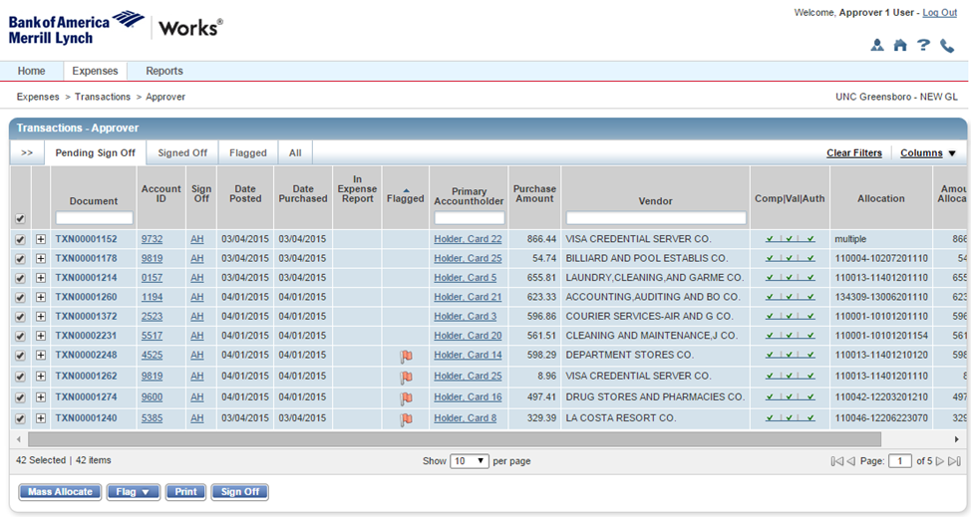
When you have finished reviewing, use the check box to select all transactions you would like to sign off on and click the “Sign Off” tab at the bottom.
To select, you may check the top box for ALL or only check the specific box of the transaction you want signed off.

Slide 11
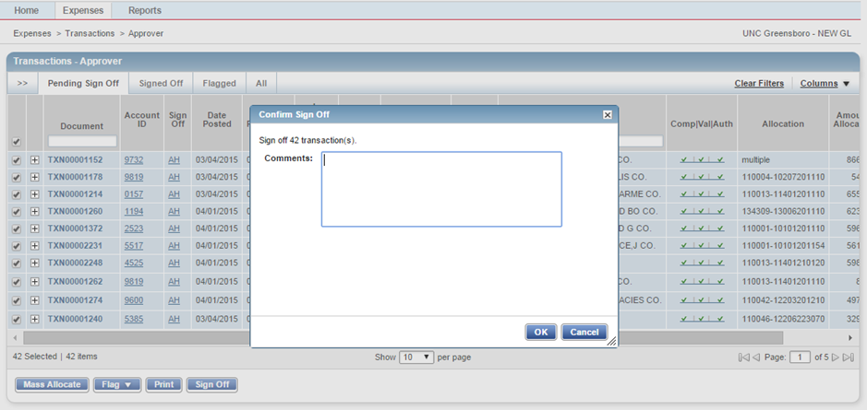
After you click the “Sign Off”, you have the option to enter a comment. A comment is not required. Click OK.
Your Pending Sign Off tab should now be blank and you are done.

Slide 12
Detailed Instructions
Reviewing Transactions
Flagging Transactions
Signing Off after Flagging
Running Reports

Slide 13
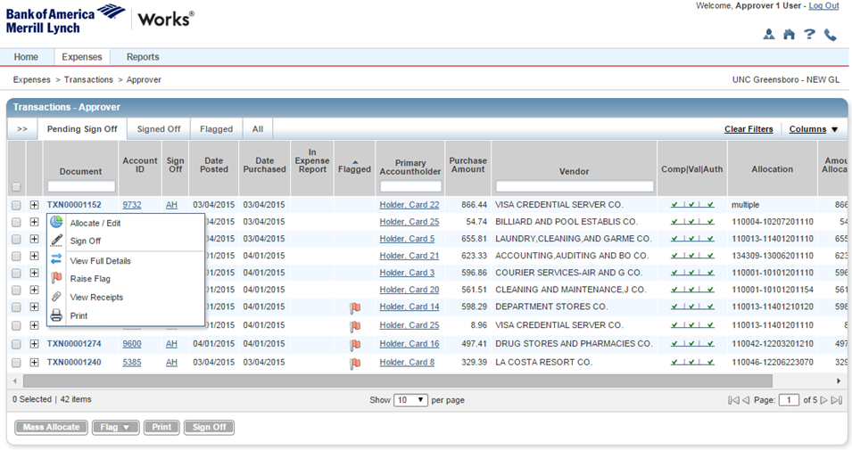
Reviewing Transactions
To see details entered by your Reconciler, click on the TXN number for the transaction your want to review. From the drop down menu, select “Allocate/Edit”.

Slide 14
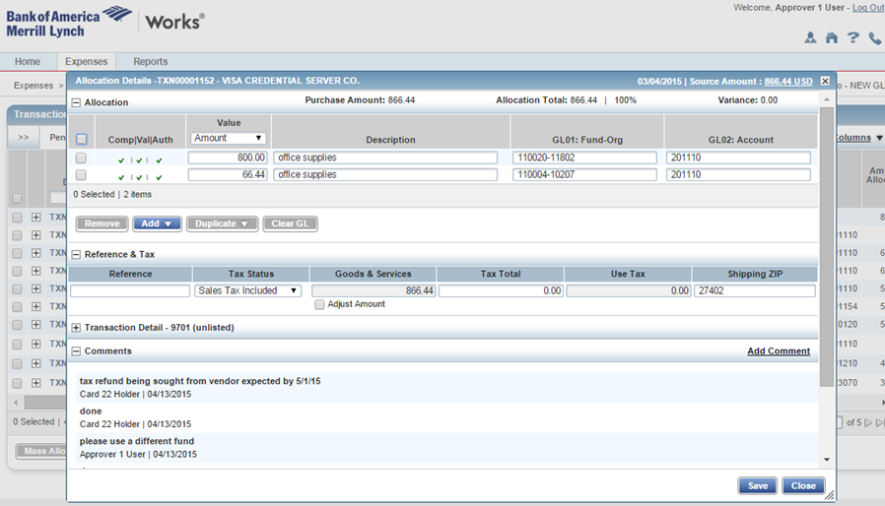
Reviewing Transactions
On the transaction detail page, you can review the information entered by the Reconciler. ALL PCARD transactions require the business purpose which includes the 5 Ws (Who, What, When, Where, and Why). This information should be input into the Description Field within the Allocation & Detail tab in Works.
Once you have reviewed, click Close.

Slide 15
Reviewing Transactions
To see receipt/documents attached by the Reconciler, click on the TXN number for the transaction your want to review and from the drop down menu, select “View Receipts”.

Slide 16
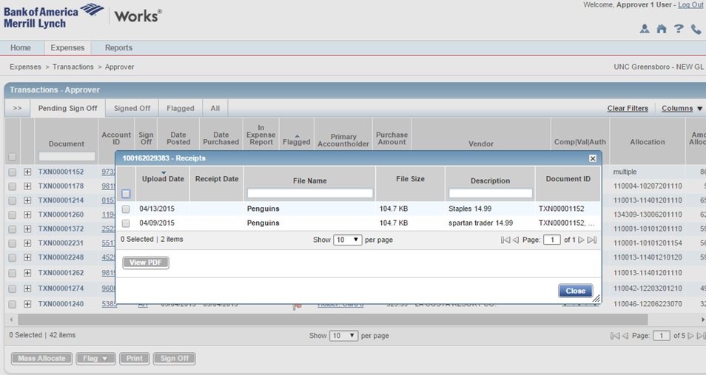
Reviewing Transactions
A pop-up window with all of the attachments for the transaction will appear.

Slide 17
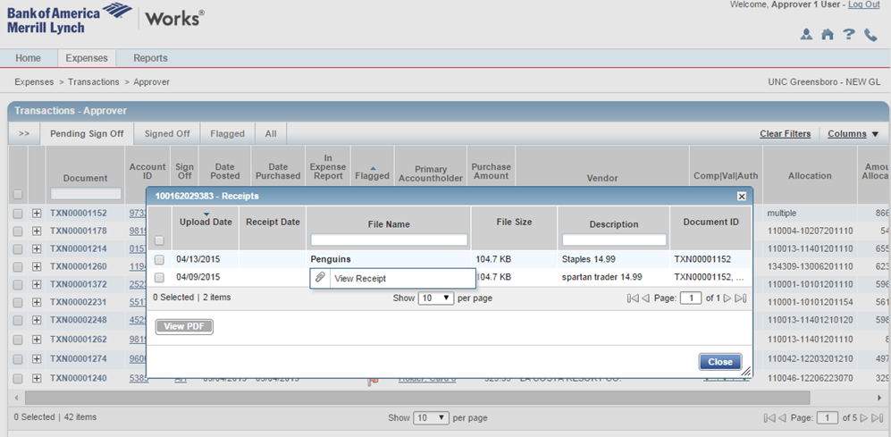
Reviewing Transactions
To view the attachment, click on the “File Name” and select “View Receipt”. A preview will pop up in a separate window.

Slide 18
Sign Off
Once finished reviewing, use the check box to select all transactions you would like to sign off on and click the “Sign Off” tab at the bottom.
To select, you may check the top box for ALL or only check the specific box of the transaction you want signed off.

Slide 19
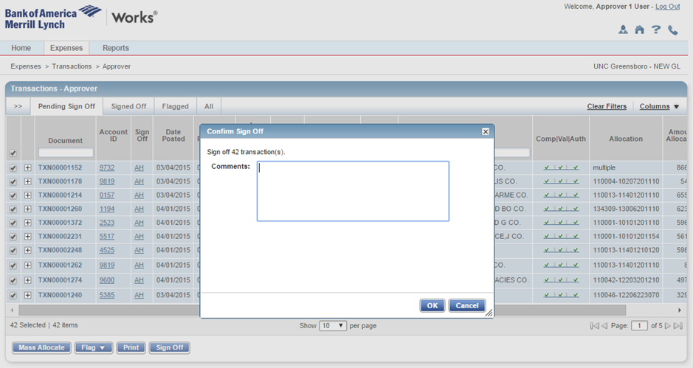
Sign Off
After you click “Sign Off”, you have the option to enter a comment. A comment is not required. Click OK. Your Pending Sign Off tab should be blank.

Slide 20
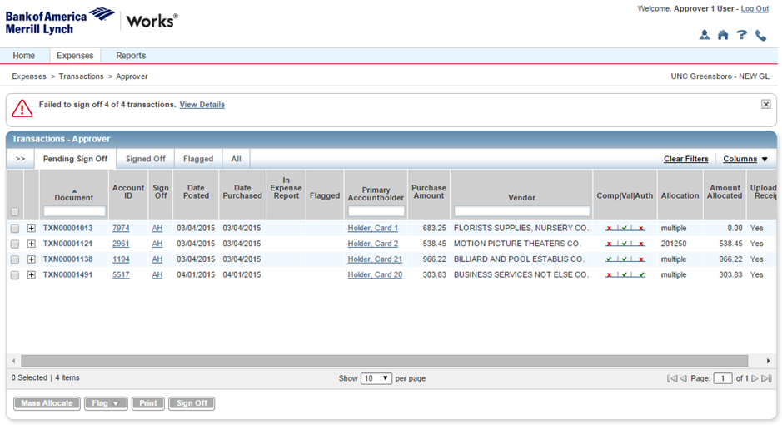
Post Sign Off Corrections
If any transactions did not sign off successfully, something is missing.

Slide 21
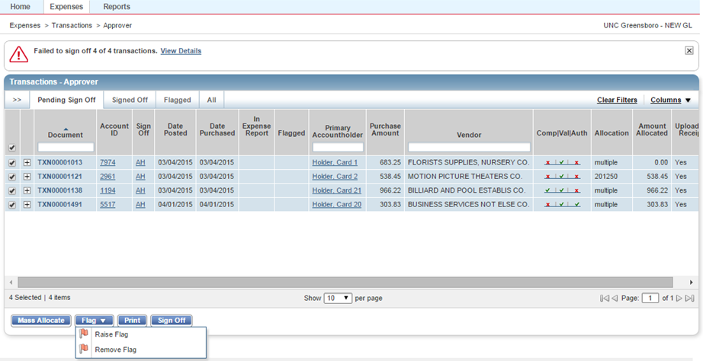
Post Sign Off Corrections: Flagging
If something is missing, or in your review you want something changed, flag the transaction to be sent back to the Reconciler to fix. Select the transaction(s) to flag and click “Flag”, then choose “Raise Flag”.

Slide 22
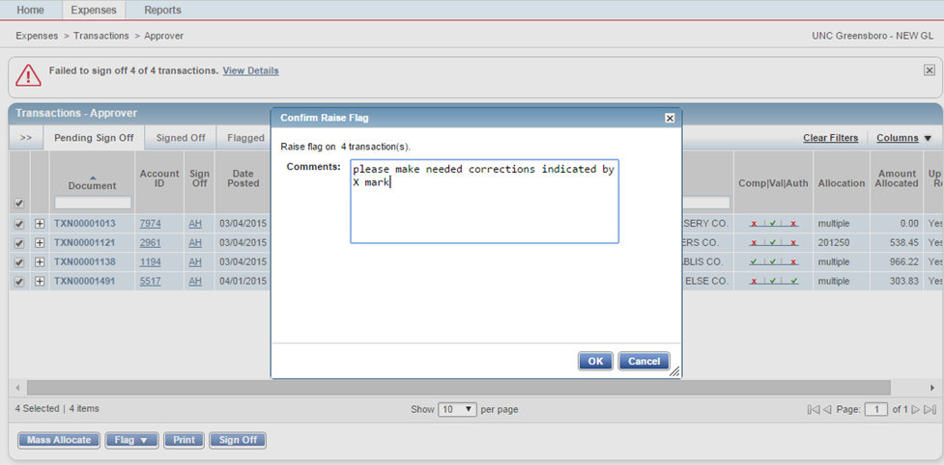
Post Sign Off Corrections: Flagging
Leave a comment to let the Reconciler know what needs to be fixed. Click OK. The Reconciler will receive and email notification that there is flagged transaction(s).

Slide 23
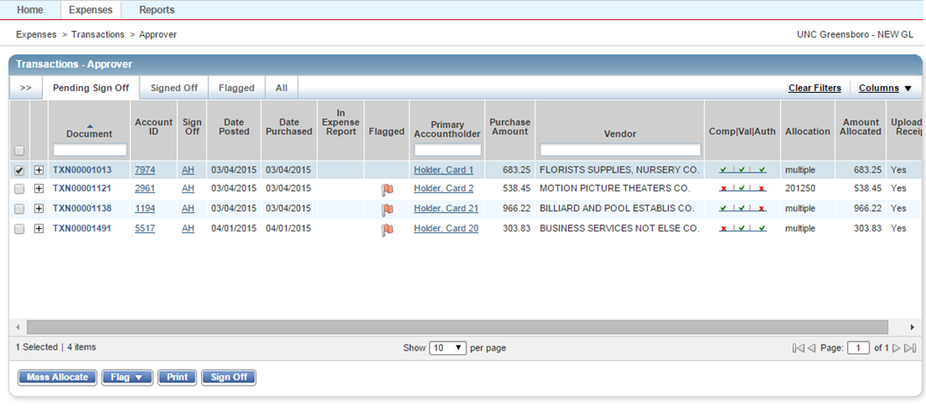
Post Sign Off Corrections: Remove Flag
Once the Reconciler has made corrections, you will receive an email that they removed the flag after making changes. You can now review the corrections. When satisfied with the corrections, select the transaction(s) and choose “Sign Off”.
Reconciler removed flag after correcting

Slide 24
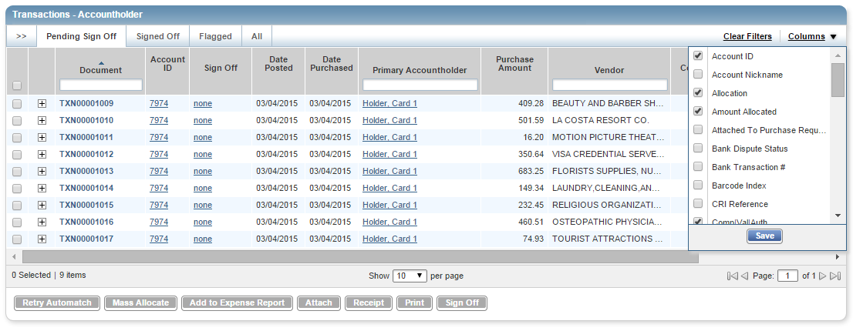
Useful Features: Transaction View and Customization
To customize your view, you can drag and drop columns to the left or right and add/delete columns by clicking on the Columns dropdown. “SAVE”.
TXN # is issued by the bank
Account ID is the last 4 #s on the card

Slide 25
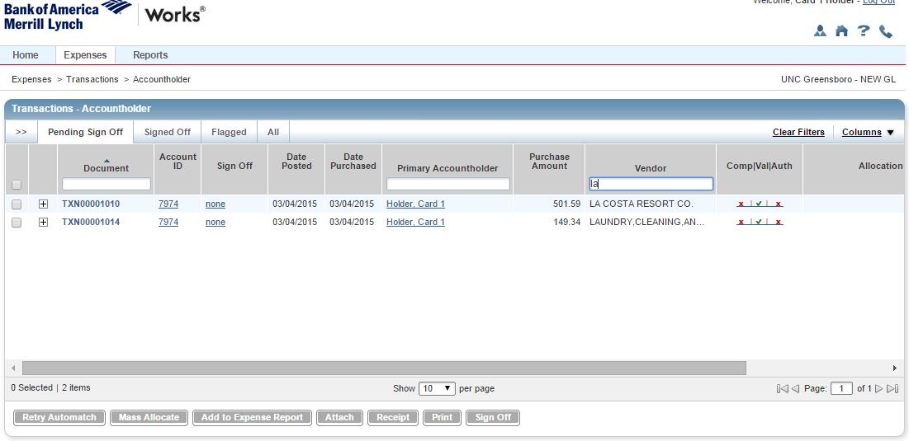
Useful Features: Search for a Transaction
To search for a specific transaction, you can filter by Vendor, Card holder (Primary Accountholder), or TXN number.

Slide 26
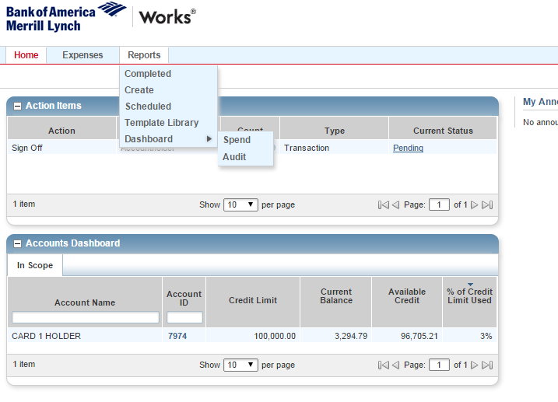
Reports
The Reports tab provides a number of reporting options. You can create custom reports, access report templates, or view a dashboard of transactions based on parameter you enter. Custom reports are flexible for your data needs. If you use custom reports frequently, you may want to consider making the report a template.

Slide 27
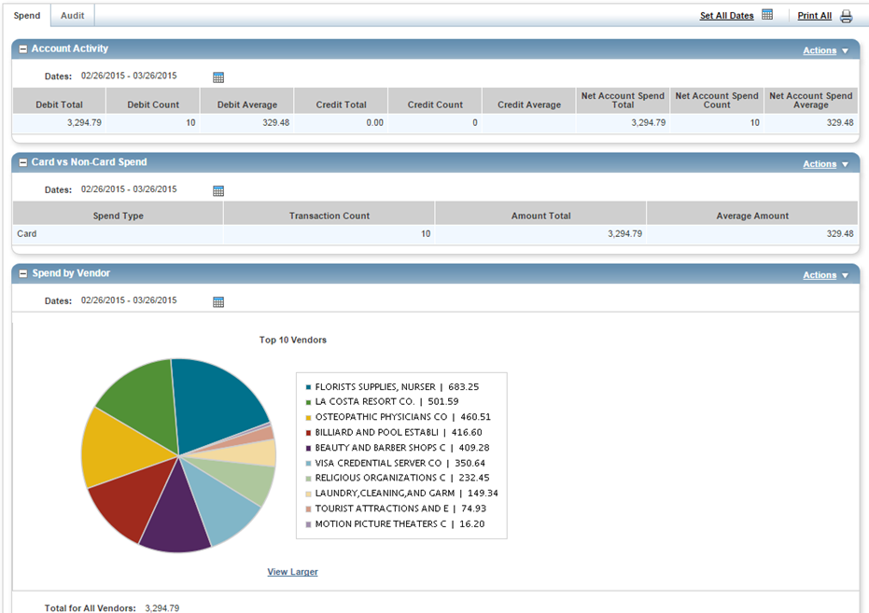
Reports
Use the Spend tab to view information about your Group’s expenses. Adjust the dates to capture only the information you want to see. Use the “Actions” drop down above each category to export the report as an .xls, .pdf, .txt file.

Slide 28
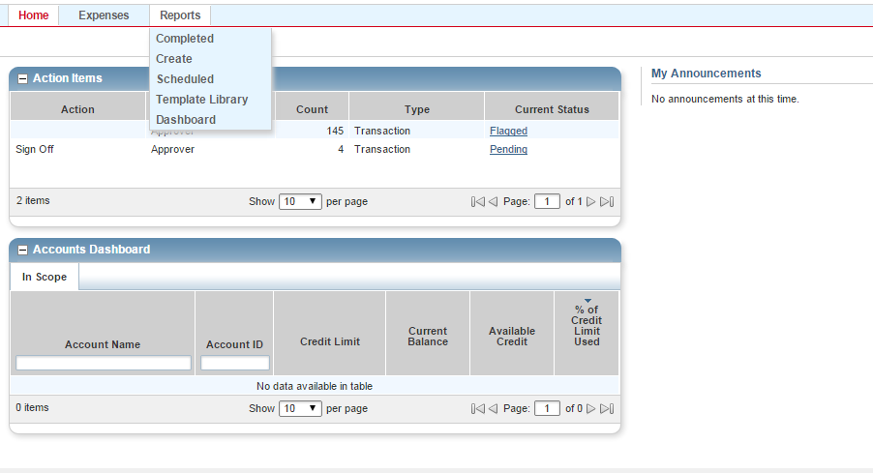
Custom Reports
You can create custom reports using a variety of templates. To create a new report, choose Reports and select “Create”.

Slide 29
Custom Reports
You can choose from a several categories and templates. “Spend” category is the most useful. “Billing Statement” and “Payable Allocation Detail” provide the best detail for budgeting and analysis.

Slide 30
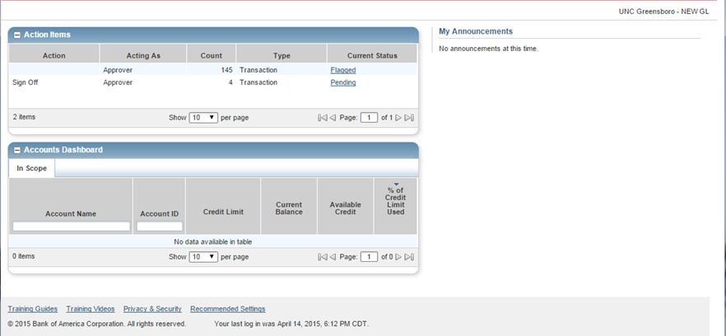
Custom Reports
You can then customize the report to show the information of your choosing.
For detailed information about creating and managing reports, visit the training guides and training videos provided by Bank of America Merrill Lynch.

Slide 31
Contacts
Michael Logan-Director of Procurement Services
mflogan@uncg.edu
336-334-4104
Valerie Nall-PCard Administrator
pcard@uncg.edu
336-334-4461

