Slide 1
Procurement Services
Works Training for the Reconciler
Reconciler- AKA Coordinator, Proxy Reconciler, or Backup Reconciler

Slide 2
Who’s Who?
Michael Logan-Director of Procurement Services
Valerie Nall-PCard Administrator
Bank of America Merrill Lynch- Works
Group
Approver
Reconciler
Card Holder
Default Fund

Slide 3
Outline
About the PCard
Reconciler Responsibilities
Reconciliation Timeline
Failure to Reconcile
Reconciliation Tips
Works Step-by-Step
Login and Profile
Receipt Upload/Attachment
Fund/Accounts
Other Useful Features and Reporting

Slide 4
Spending Limitations
Maximum Spending Limits
STL $4,999.99 Limit per purchase
DTL $10,000.00 Limit per day
MTL $25,000.00 Limit per month
The PCard is not a personal credit liability, unless unauthorized purchases are made.
The Cardholder is the ONLY authorized user of the card!

Slide 5
A Listing of allowable and unallowable purchases may be found on the Purchasing website:
https://purchasing.uncg.edu/pcard/
No personal charges allowed
Splitting transactions to circumvent limits is prohibited
If you are wanting to buy software it should be approved by ITS prior to purchase:
https://policy.uncg.edu/university-policies/applications_prepurchase/

Slide 6
UNC Greensboro Business Purpose Use Only
Always receive permission from your budgetary authority BEFORE making purchases with your PCard.
You can be held financially responsible for any unauthorized purchase.
Refer to Purchasing Policies: https://purchasing.uncg.edu/policies/
Refer to Spending Guidelines: https://banner.uncg.edu/budget/sample-page/spending-guidelines/
When in Doubt, Check it Out.

Slide 7
NC Tax Exempt #
400004
All UNC Greensboro Purchasing Practices Apply.
Walmart, Best Buy require you to register your department to be tax exempt. If you choose to use them for purchases you will need to contact their Customer Service to set up your Individual Exempt Account Number.
Office Depot Account # 24951479
Lowe’s Home Improvement # 038700007

Slide 8
Reconciler Responsibilities
Gather and maintain receipts of purchases from cardholders
Scan and upload/attach receipts to the transactions in Works
Assign funds/accounts to transactions in Works
Meet monthly cycle deadline by reconciling often
Assist card holder with lost/stolen cards or fraudulent charges
Assist card holder with disputed transactions
Request cancellation of unused cards - This includes cards that belong to employees leaving your department or leaving UNC Greensboro.
Serve as point of communication between card holders and PCard Office
Update card holders on changes to PCard Policies and Procedures
Note: All supervisors of newly separated employees must complete the PCard-Works Maintenance Form “Close/Deactivate Account” section. Submit this form to the PCard Administrator. The PCard may be securely destroyed in your office.

Slide 9
Reconciliation Timeline
Purchases
Card holder makes the purchase
Card holder submits the original receipt to the Reconciler
Upload Receipts to Posted Transactions
Reconciler uploads the receipts to the transaction in Works
Allocate/Edit funds/accounts to the transactions in Works
Sign off on transactions to go to the Approver for their review and sign off
Reconcile
Approver reviews and signs off on the transactions
PCard Administrator uploads reconciled transactions from Works to Banner.

Slide 10
Billing Cycle
The monthly cycle includes transactions completed with the POST DATES (not the Transaction Dates) from the 26th-25th of the month.
Reconciliation Cycle
All transactions in the cycle showing a POST DATE of the 26th through the 25th should be reviewed and signed off by the Approver by the 5th of the month for reconciliation.
The reconciliation date is the 5th of the month unless it falls on a weekend or holiday.
WEEKENDS AND HOLIDAYS WILL AFFECT THESE DATES

Slide 11
Encumbrances to your UNC Greensboro Funds
Departmental Funds may be encumbered within 24 hours AND the PCard Administrator has batched the transactions (Batches are uploaded via internal FUPLOAD that is processed approximately 2-3 times per week.)
Funds will be able to be seen in Banner.
Total monthly charges may be viewed on your EPrint reports.

Slide 12
Failure to Reconcile
Unreconciled Transactions
Departments that fail to reconcile their transactions by the 5th, will have their transactions charged to the Default Banner Fund and the approval signature will be forced.
The card holder of the unreconciled transaction may be suspended until written notification is received explaining the situation.
First Offense-WARNING
Second Offense-Card is FROZEN
Third Offense-Card is REVOKED

Slide 13
Reconciliation Tips
Service vs. Product…
If you are paying for a service with the PCard, please verify the vendor is incorporated or LLC. If the vendor is not incorporated or LLC, they could be an Independent Contractor. Contact Procurement Services.
Receipt Requirements
Each transaction requires an itemized receipt that includes a total.
Credits should also have a receipt. If they do not, attach the receipt that shows the original charge and include an explanation.
All receipts should be from the actual vendor.
International Transaction fees ONLY do not have to have a receipt.

Slide 14
Declined Transactions
If your card is declined, call the PCard Administrator at 336-334-4461.
Most declines are due to the MCC code. (Merchant Category Code) These codes are assigned by the vendor’s/merchant’s card company when the vendor/merchant starts accepting credit cards as a form of payment.

Slide 15
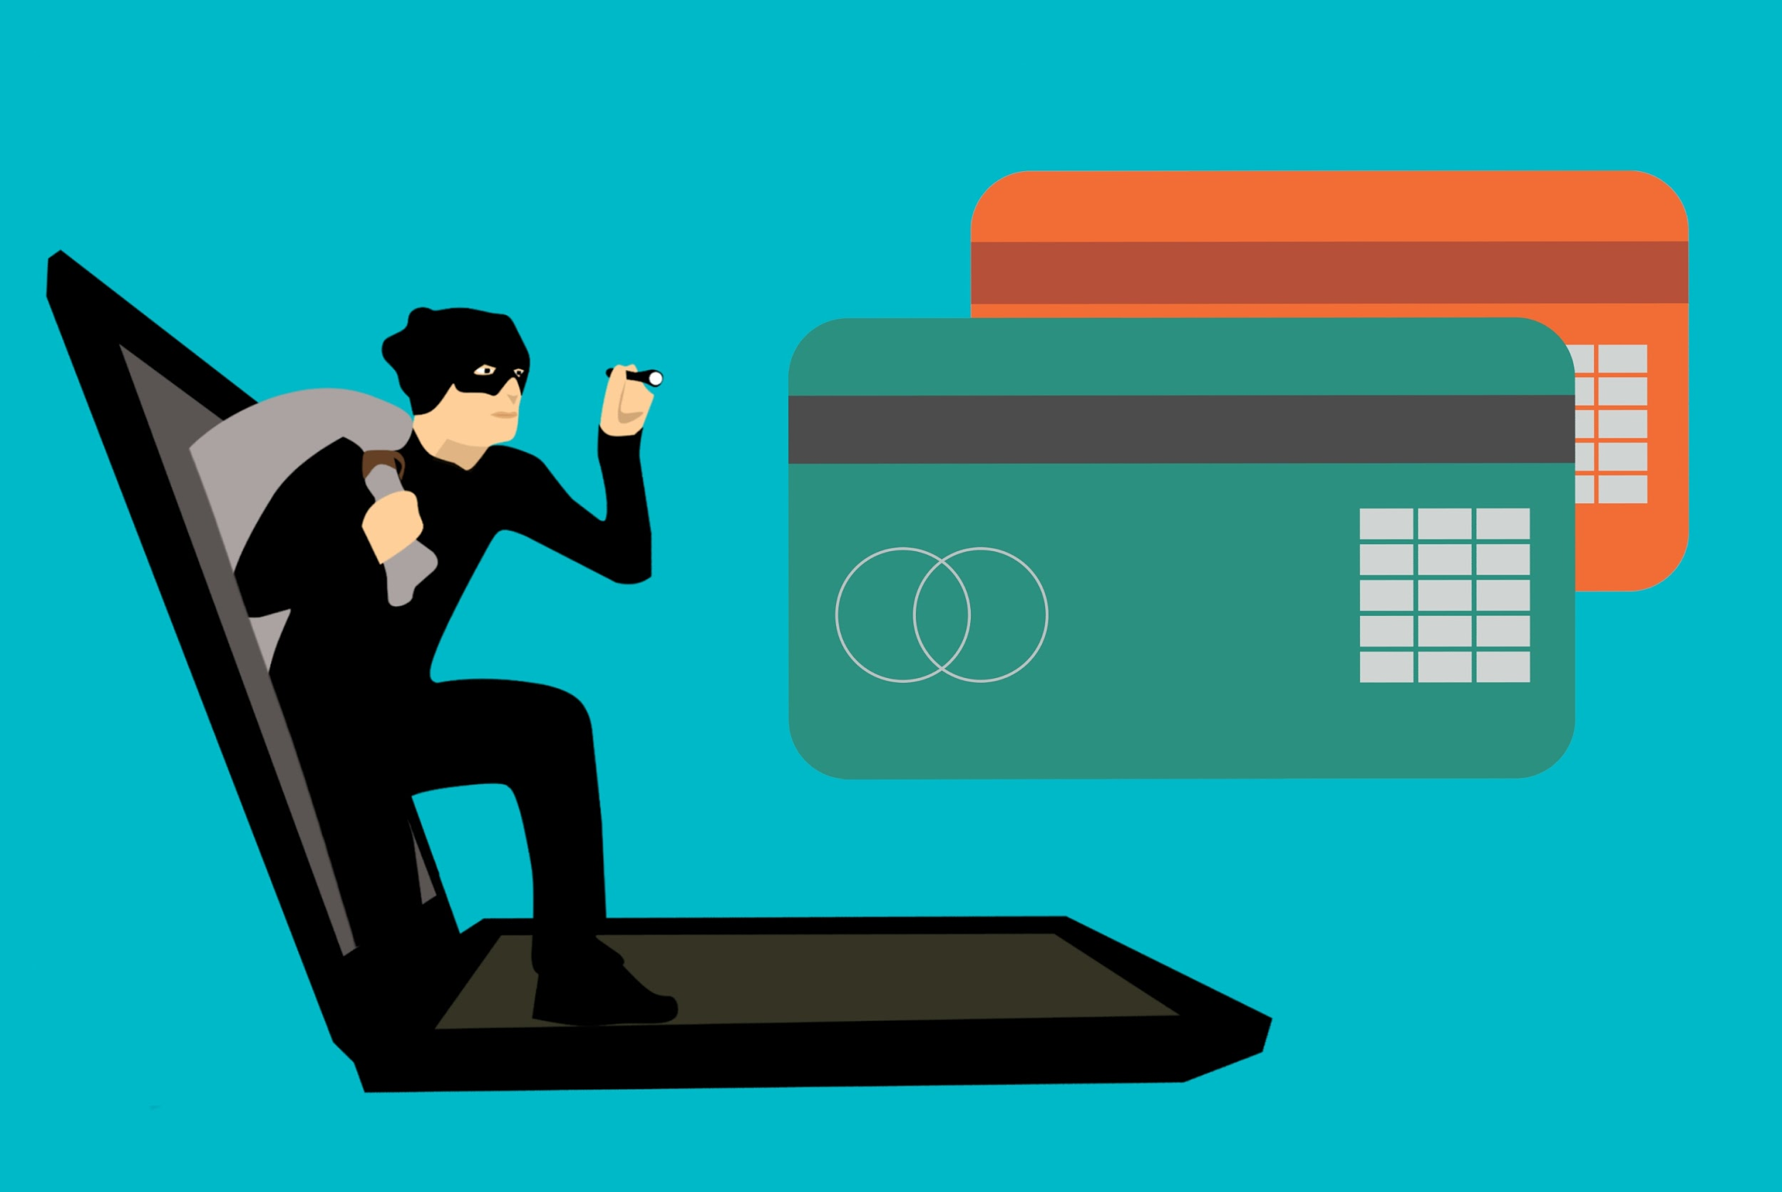
Lost/Stolen Cards
Call Immediately
Bank of America Merrill Lynch-888-449-2273
PCard Administrator 336-334-4461
A new card will be sent to the PCard Office within approximate 3-5 business days.

Slide 16
Disputed Transactions
Card holder contacts:
Vendor to see if the situation can be handled at that level.
If not, card holder contacts Reconciler to “dispute” the transaction within the Works system. (Preferred method.)
Or, the card holder may print, sign and fax the dispute form to the bank.
Notify the department Reconciler and PCard Administrator about the situation.
Dispute form is located: https://purchasing.uncg.edu/pcard/

Slide 17
Tips and Reminders
Reconcile often-reconciliation is not complete until signed off by the Reconciler AND Approver.
Monthly cycle Post Dates 26th-25th. Deadline is the 5th. (Dates are affected by weekends and holidays.)
Transactions will encumber funds in Banner around 2:30 pm on the day a BATCH has been processed from Works to Banner by the PCard Administrator.
Approver or PCard Administrator may flag transaction requesting changes, receipts, documentation needed, etc.
More documentation is better.
Stay within available budget.
State Term Contracts apply.
Willful misuse will NOT be tolerated.

Slide 18
Reconciling in Works
Step-by-Step

Slide 19
Introduction to Works
Works is a web-based application offered by Bank of America Merrill Lynch. The web address:
payment2.works.com/works

Slide 20
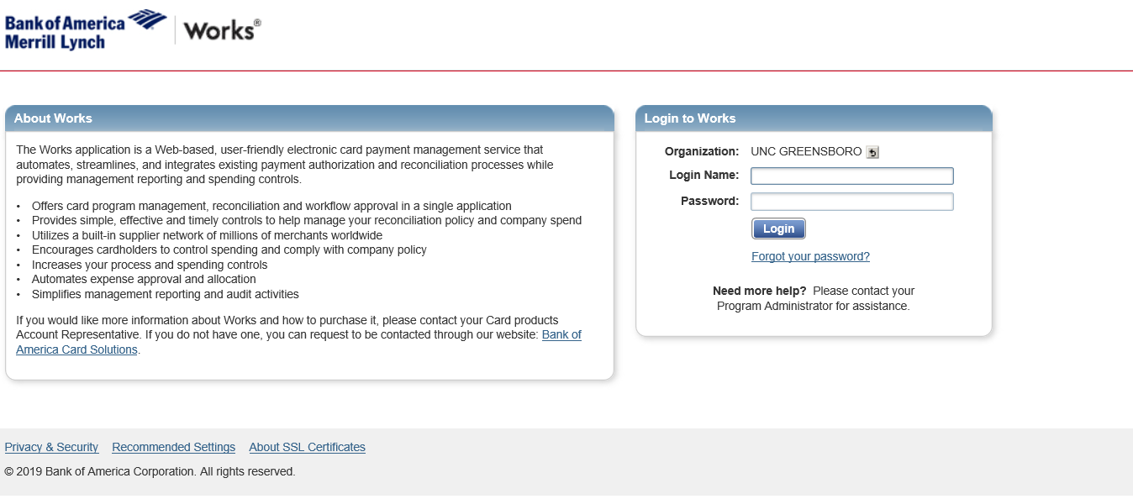
Login
Your username and password my differ from your Banner username and password
Your login name will be set up at the time the PCard Administrator receives the paperwork to add you as a Reconciler.

Slide 21
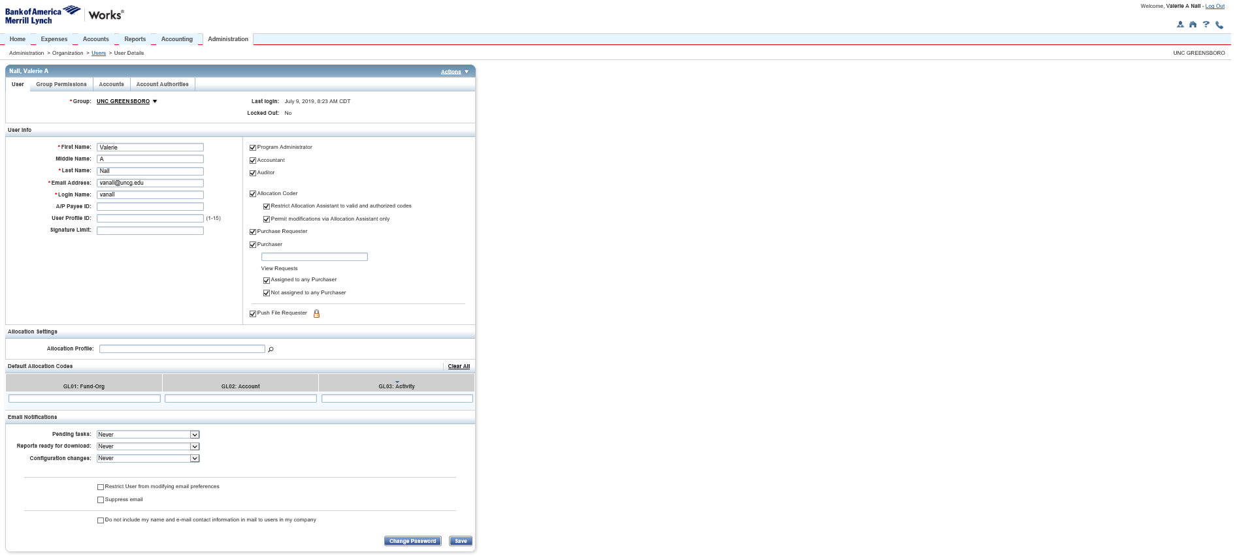
Notification and Profile
Automated emails are sent when there are transactions requiring reconciliation/attention.
Note: Notifications are sent to ALL Reconcilers at the same time. Reconcilers receive notifications depending on how often they have chosen to receive them. The default is set at “Daily”.
Select the person symbol to modify your settings.
Select from Immediately, Daily or Weekly for email notifications. Make sure to “Save”.

Slide 22
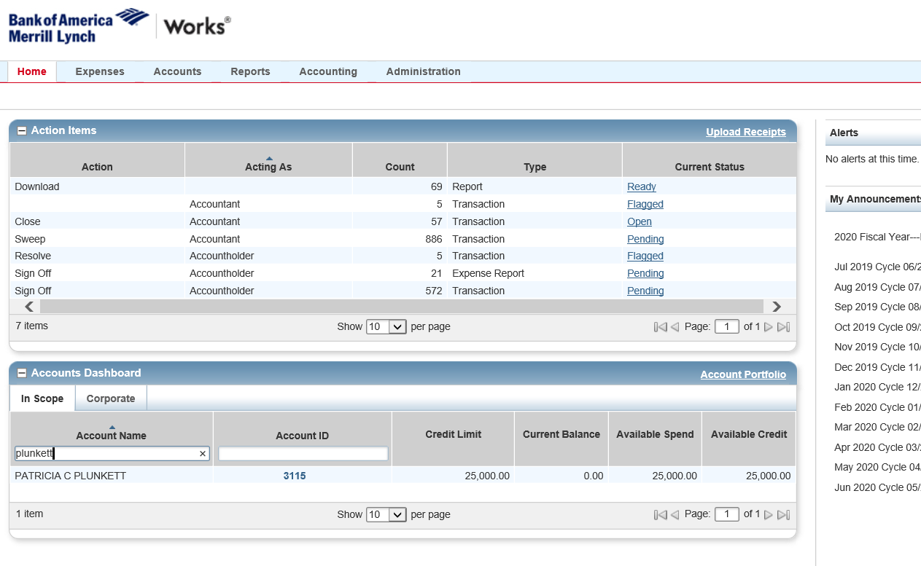
Reconciling in Works
From the HOME screen, you will select >Expenses>Transactions>Accountholder OR you may click on the PENDING hyperlink in blue.
PENDING shows the number of transactions requiring action from the Reconciler.
ACCOUNTS DASHBOARD lists all of the cardholders in your group with their account information.

Slide 23
Reconciling
Scan and Save the receipts to your desktop or in a folder on your desktop for easy retrieval. Please give each receipt a unique name. Once all of the receipts have been scanned and saved you will be able to add them to your transactions in Works.
Receipt image/PDF file size must not exceed 1 MB
Can be .pdf, .png, .jpg, .gif and .jpeg
Reconcilers will upload/attach receipts and allocate funds/accounts to each transaction in Works. When choosing Expenses>Transactions>Accountholder OR Pending, this will take you to the reconciliation process.

Slide 24
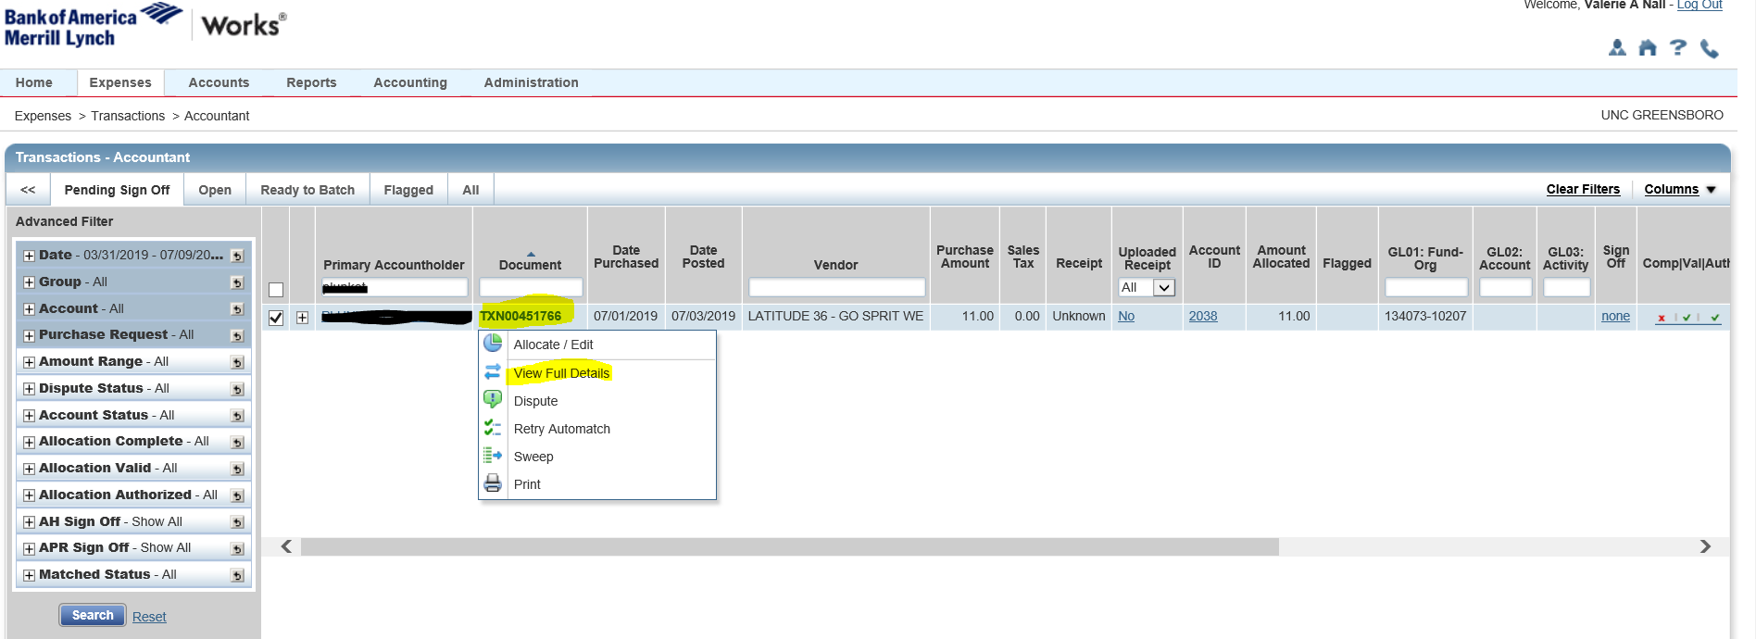
Attaching Receipts
Hover over the transaction number, TXN00XXXXXX, and choose View Full Details from the drop down arrow menu.

Slide 25
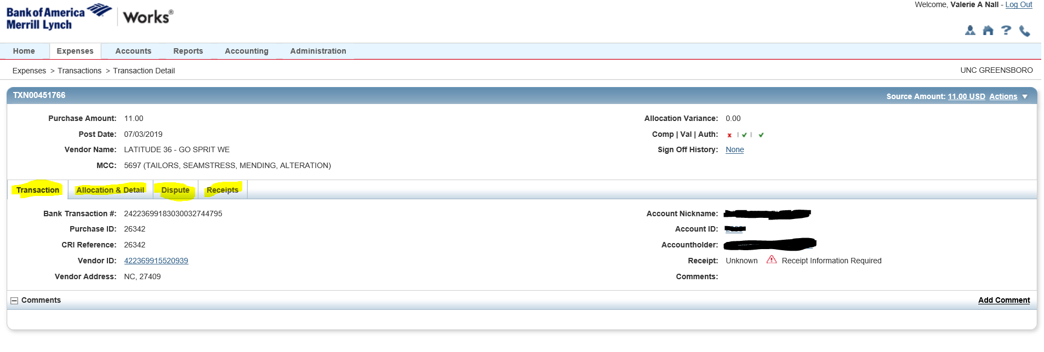
Attaching Receipts
Choosing “View Full Details” allows you to see everything that is provided from the bank for this specific transaction. The tab options available: Transaction, Allocation & Detail, Dispute and Receipts.
Select Receipts.

Slide 26
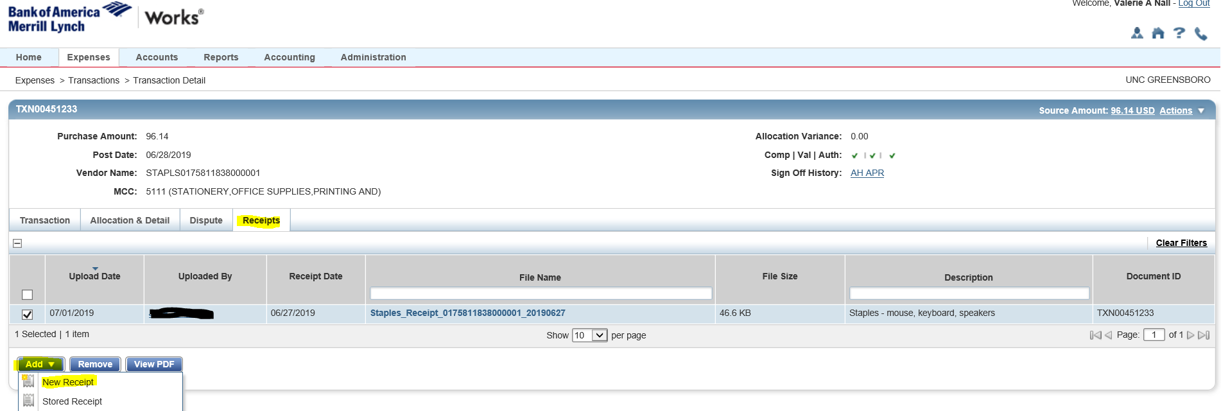
Attaching Receipts
Select Add
a. New Receipt (if you saved on your desktop or folder on computer).
OR
b. Stored Receipt (if you uploaded the receipt to the “Works Receipt Library”.
Note: Preferred Method is “New Receipt”

Slide 27
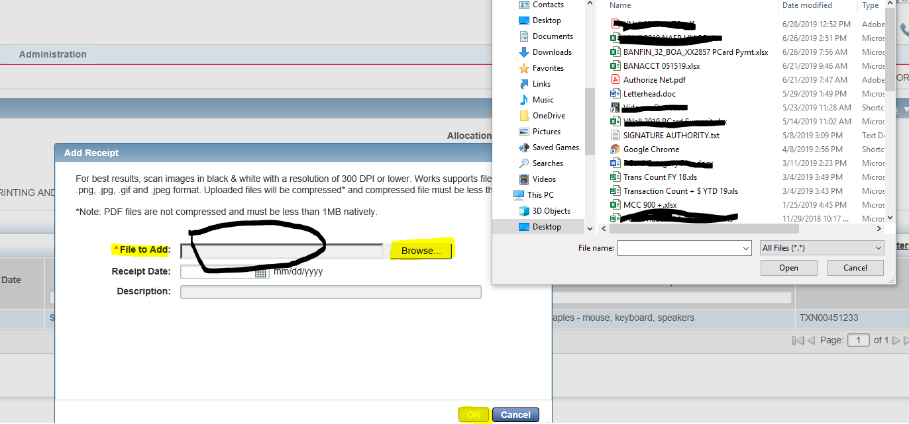
Attaching Receipts
Double click within “File to Add” field or click “Browse” to locate the specific receipt that you saved on your desktop or in your file folder.
When you have located the correct receipt, double click on the receipt file name and it will automatically populate.
Click OK.

Slide 28
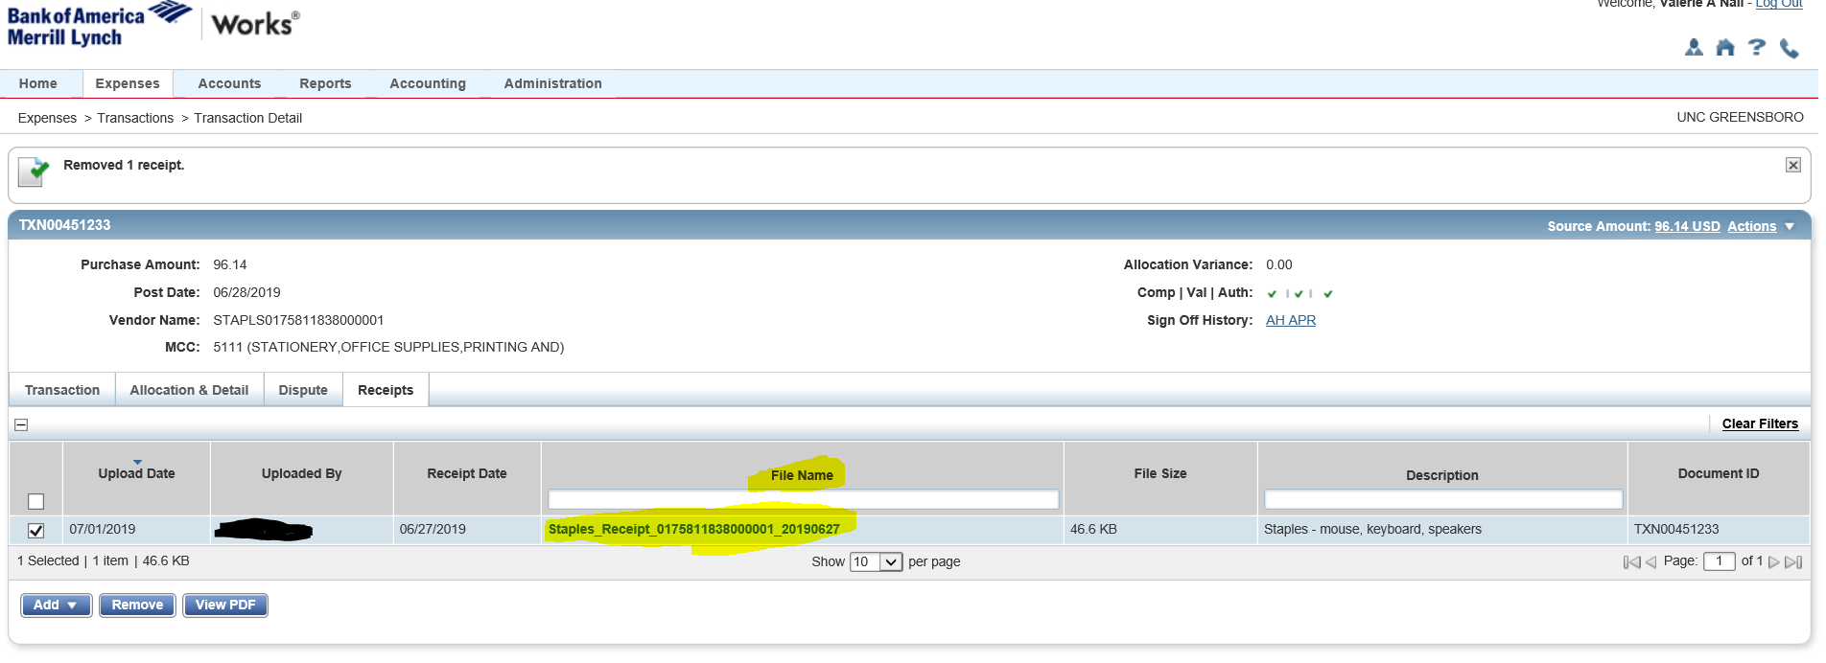
Attaching Receipts
Your receipt has been added.

Slide 29
Allocation & Detail
Allocating the fund and account to the transaction.
Select Allocation and Detail.

Slide 30
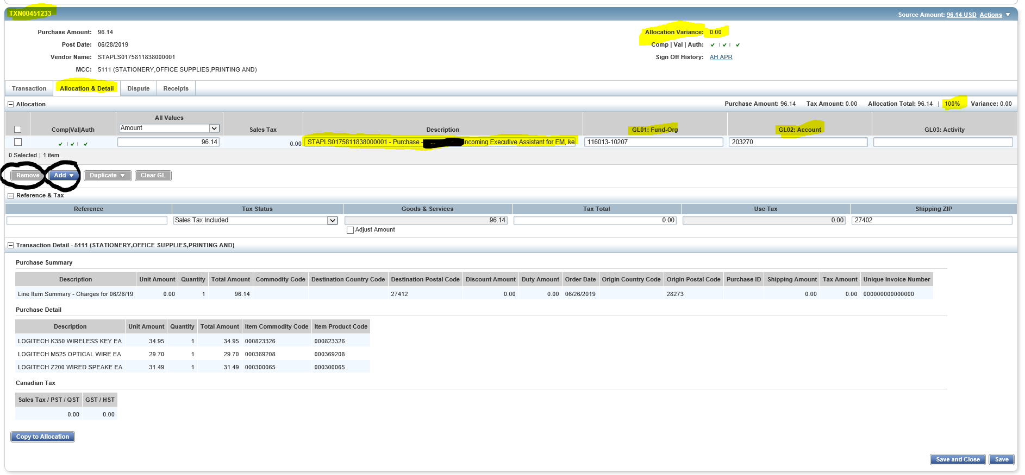
Allocation & Detail
Allocating the fund and account to the transaction and providing description to purchase
Select Allocation & Detail
Input description-As of 08032020, ALL PCARD transactions require the business purpose which includes the 5 Ws (Who, What, When, Where, and Why). When inputting the 5 W information in the Description Field, please leave the vendor name as it automatically shows up and remove the word "purchase". If you need guidance, please review the examples of allowable business purposes on the PCard website within the Business Purpose tab.
Assign Fund (GL01: Fund-Org) if the Default Fund is not the one you wish to use, choose from the funds that you have access to based on fund availability and Security Access.
Assign Account Code (GL02: Account) by typing an account the accounts will start to populate, choose the correct one. Note: You may add lines for multiple fund/account assignments or remove if not needed. You only have access to the funds assigned to your group in the Works system.
The vendor name will default in the Description field. Leave the vendor name as shown and include the Business Purpose with the 5 W’s-Who, What, When, Where, Why. This field allows up to 450 + characters. When the transaction encumbers your funds, the description up to 35 characters will be included in the Banner journal entry.

Slide 31
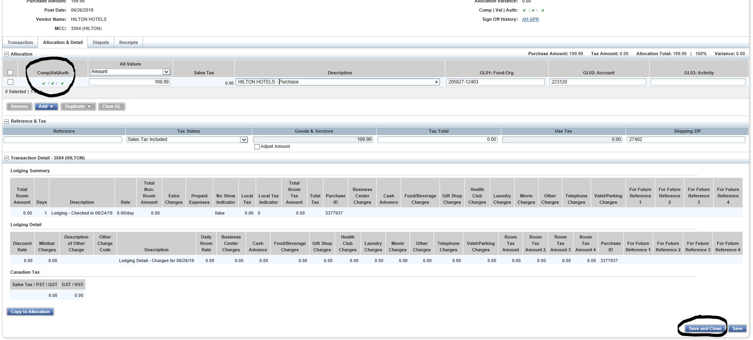
Allocation & Detail
Once you have attached the receipt and assigned the fund and account, you should see the 3 green check marks when the transaction is ready for approval. When you have finished allocating, etc., click Save and Close.

Slide 32
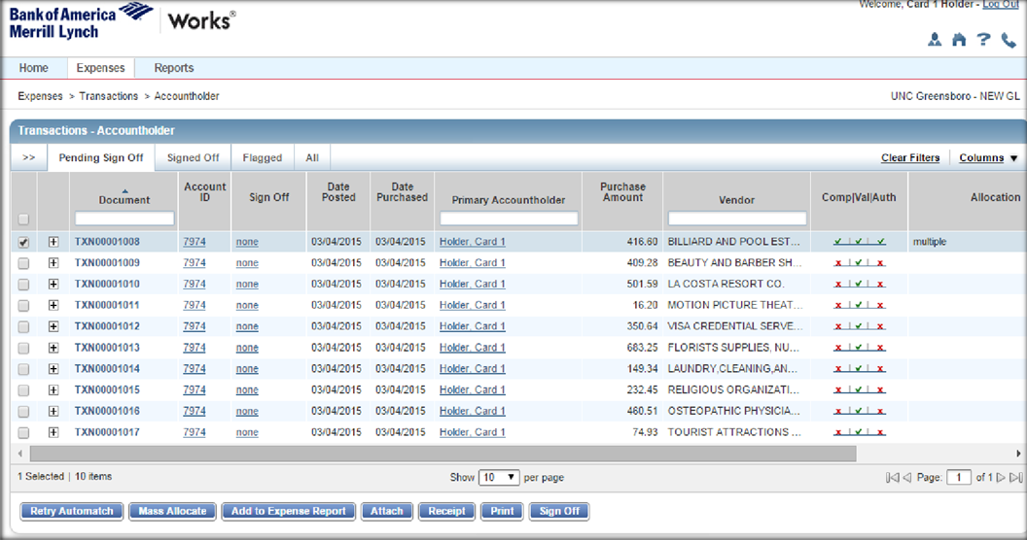
Reconciler Sign Off
Reconciler signs off on transactions ready for the Approver’s review and sign off.
When ready to send transactions to Approver, choose the box to the left of the transaction number and click “Sign Off”. Reconciler is finished UNLESS the Approver or PCard Administrator flags the transaction. Note: transactions are not fully reconciled until signed off by the Approver and all flagged issues have been resolved.

Slide 33
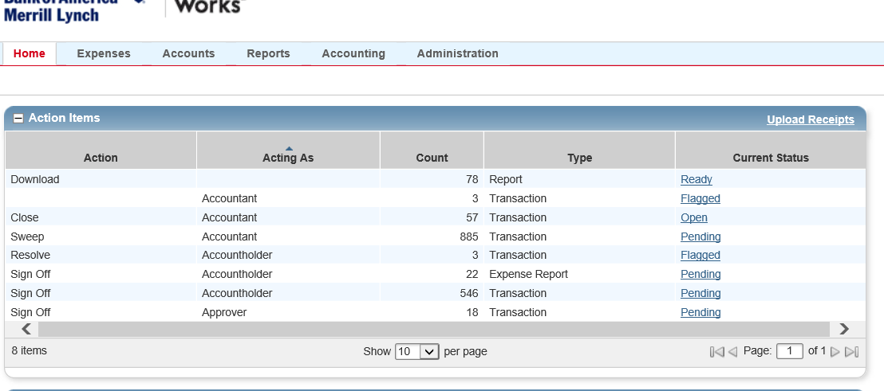
Flagged Transactions
Due to missing receipts or a wrong receipt attached, incorrect funds or accounts or important information not provided, the Approver or the PCard Administrator may elect to flag a transaction. When a transaction is flagged by the Approver or PCard Administrator the Reconciler(s) will receive a notification via email that a transaction needs to be addressed along with a “comment” of what is being requested.
Click on the blue hyperlink “Flagged” on the HOME page.

Slide 34
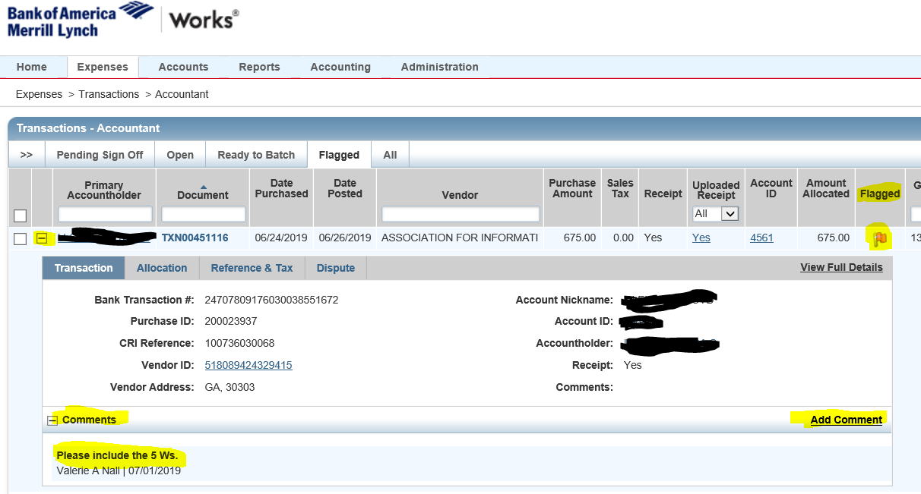
Flagged Transactions
To view why the transaction was flagged
Click on the +/- sign on the left side the transaction to view the reason for the flag under “comments”.
Make the necessary changes by selecting the transaction, “View Full Details” and going back into the transaction. After modifications have been made, Save and Close.
Remove flag by choosing from the drop down arrow on the transaction number by selecting, “remove flag”, add comment and click OK.
After the flag has been removed, the transaction will go back to the person who flagged the
transaction, either the Approver or PCard Administrator.

Slide 35
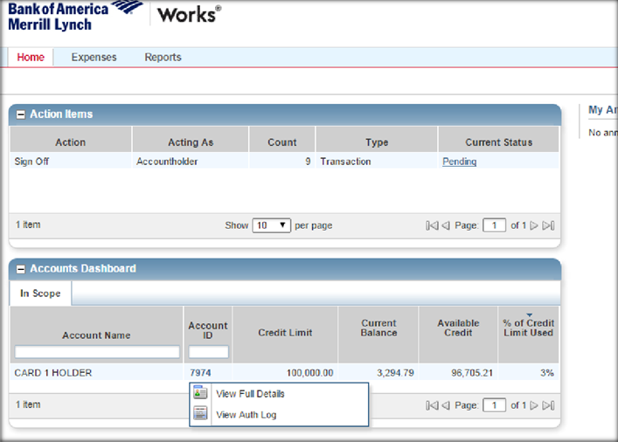
Useful Features
Declined Cards
If a card is being declined, you may view the reason in the Accounts Dashboard on the Home page by choosing the card holder’s profile. Click on the card ID and “View Auth Log” to see pending and declined transactions. If you see a Decline by Score 1, this means fraud and the card holder will need to contact the bank. MCC exclusion, email the PCard Administrator with the 5 W’s and fund information so the card can be opened to allow the transaction to go through.

Slide 36
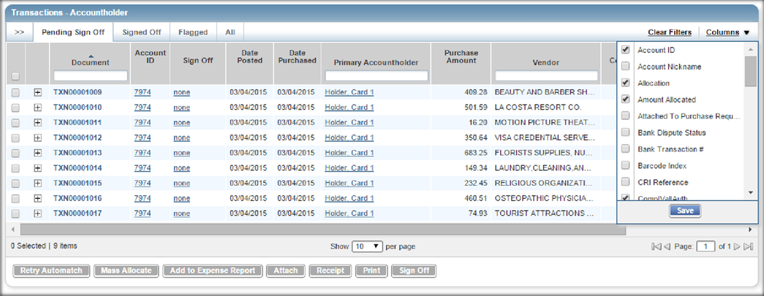
Transaction View Customization
To customize your view you can drag and drop columns to the left of right, add/delete columns of
information by clicking on the Columns dropdown.
Document is Transaction Number-This is issued by the bank.
Account ID is the last 4 digits on the credit card.

Slide 37
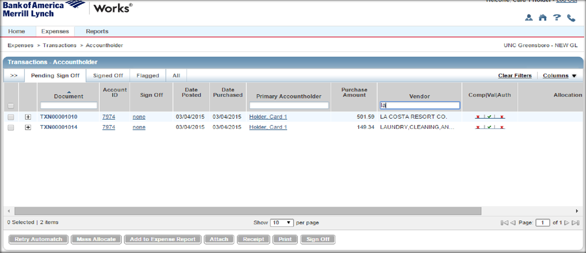
Search Transactions
To search for a specific transaction, you can filter by Vendor Name, Card holder or TXN number. You can input the partial name or number and the TXN number/Card holder/Vendor that has those characters will populate.

Slide 38
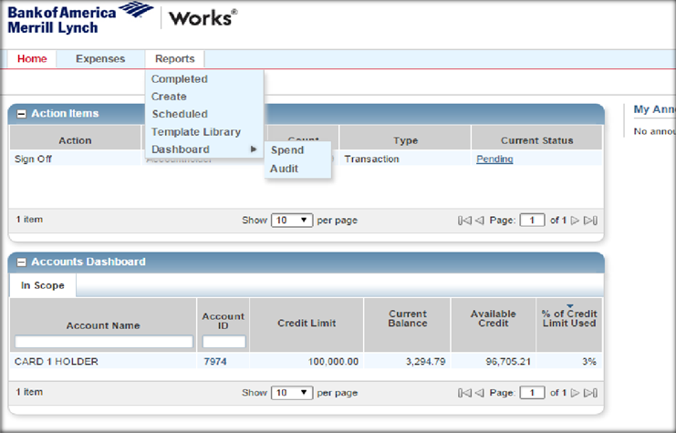
Reports
The Reports tab provides a number of reporting options. You can create custom reports, access report templates, or view a dashboard of transactions based on parameters you enter. Custom reports are flexible for your data needs. If you use custom reports frequently, you may want to consider making it a template.

Slide 39
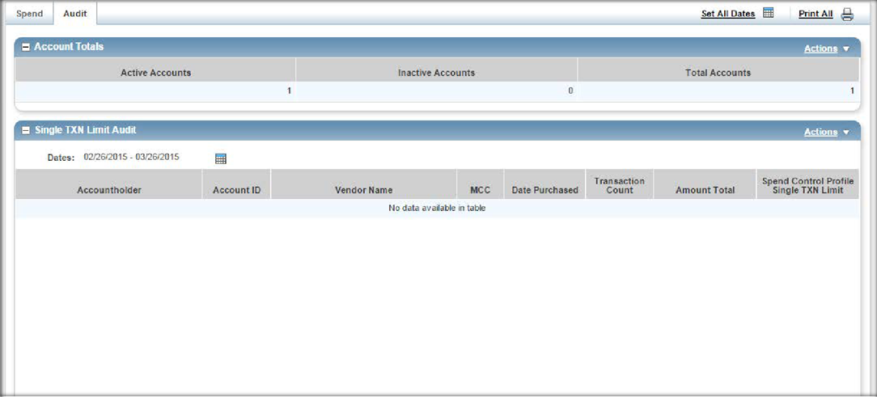
Dashboards
Use the Audit tab to find out when “split” transactions have been made within a specific PCard cycle.
Single TXN Limit Audit shows when a card has exceeded the Single Transaction Limit during a specific PCard cycle.

Slide 40
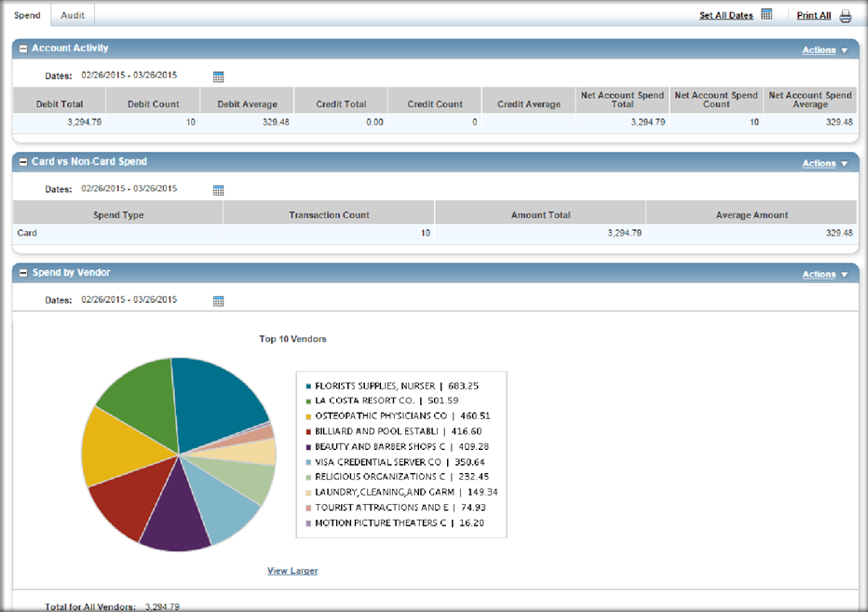
Dashboards
Dashboards
Spend
Use the Spend tab to view information about your Group’s expenses. Adjust the dates to capture only the information you want to see. Use the Actions drop down above each category to export the report as an .xls, .pdf or .txt file.

Slide 41
Contacts
Michael Logan-Director of Procurement Services
mflogan@uncg.edu
336-334-4104
Valerie Nall-PCard Administrator
pcard@uncg.edu
336-334-4461

